Slide 1

Hands-On Ethical Hacking and Network Defense, Edition 4
Module 6: Enumeration
Simpson, Antill, Wilson, Hands-On Ethical Hacking and Network Defense, 4th Edition. © 2023 Cengage. All Rights Reserved. May not be scanned, copied or duplicated, or posted to a publicly accessible website, in whole or in part.

Slide 2
Module Objectives
By the end of this module, you should be able to:
Describe the enumeration step of security testing
Enumerate Windows OS targets
Enumerate *nix OS targets

Slide 3
Introduction to Enumeration (1 of 2)
Enumeration refers to the process of extracting information from a network about the following:
Resources or shares on the network
Network topology and architecture
Usernames or groups assigned on the network
Information about users and recent logon times
Port scanning and footprinting
Used to determine what operating system (OS) is used
Enumeration is more intrusive
Attempting to access a resource, not just identifying it

Slide 4
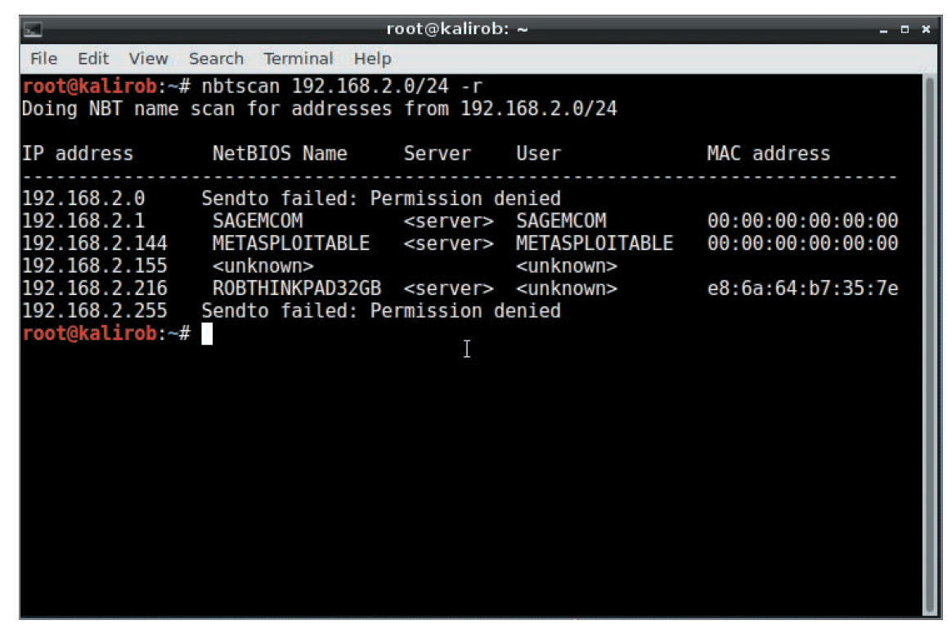
Introduction to Enumeration (2 of 2)
NBTscan (NetBIOS over TCP/IP)
Tool for enumerating Windows OSs that is part of the Kali Linux suite of security tools
Source: Kali Linux

Slide 5
Knowledge Check Activity 6-1
Which of the following testing processes is the most intrusive?
Port scanning
Enumeration
Null scanning
Numeration
Notes:
Instructions:
Use the Knowledge Check questions to periodically pose a question to students during class to gauge how well they can recall the material that was presented.

Slide 6
Knowledge Check Activity 6-1: Answer
Which of the following testing processes is the most intrusive?
Answer: b. Enumeration
Enumeration is the most intrusive part of testing for security testers.

Slide 7
Polling Activity 6-1
Security testers conduct enumeration for which of the following reasons? (Choose all that apply.)
Gaining access to shares and network resources
Obtaining user logon names and group memberships
Discovering services running on computers and servers
Discovering open ports on computers and servers
Notes:
Instructions:
1. Use this activity to solicit student opinions about concepts in the module or to play a game.
2. Go to kahoot.com, or the platform of your preference, and log in or sign up.
3. Create the challenge.
4. Teacher Tip: Turn off the timer to prioritize accuracy or turn on the nickname generator to avoid inappropriate nicknames.
5. Invite players by sharing the link or PIN.
6. This can be done synchronously during class or asynchronously for review or homework.

Slide 8
Polling Activity 6-1: Answer
Security testers conduct enumeration for which of the following reasons? (Choose all that apply.)
Answer: a. and b. Gaining access to shares and network resources and obtaining user logon names and group memberships
Security testers conduct enumeration for gaining access to shares and network resources and obtaining user logon names and group memberships using many enumeration tools.
.

Slide 9
Enumerating Windows Operating Systems
Brief look at Windows OSs
To understand how an attacker might gain access to resources or shares on a Windows network
This chapter focuses on Windows OS as it relates to enumeration
Little information can be enumerated from Windows systems after Windows 7

Slide 10
Windows OS Descriptions (1 of 7)
Windows OS version | Description
Windows 95 | The first Microsoft GUI product that doesn’t rely on DOS, Windows 95 is the beginning of plug and play and the ActiveX standard used in all Windows versions today. A major enhancement is the Registry, a database storing information about the system’s hardware and software. Previously, this information was stored in files. Windows 95 runs on stand-alone and networked computers and uses the F A T16 file system. Version OSR2 adds support for F A T32.
Windows 98 and Me | Compared to their predecessors, these versions have an improved file system (F A T32), new hardware support, and better backup and recovery tools. The enumeration process for Windows Me is the same as for Windows 98.
Windows NT 3.51 Server/Workstation | These OSs were created with security and enhancement of network functionality in mind. They emphasize domains instead of workgroups and use the client/server model instead of peer-to-peer networks; the server is responsible for authenticating users and giving them access to network resources. The client/server model also allows for having many computers in a domain instead of the limited number of computers in a workgroup. NTFS replaces F A T16 and F A T32 because of the difficulty in incorporating security in the earlier file systems. NTFS includes file-level security features not possible in F A T.

Slide 11
Windows OS Descriptions (2 of 7)
Windows OS version | Description
Windows NT 4.0 Server/Workstation | These upgrades to Windows NT 3.51 have improved GUIs and performance.
Windows 2000 Server/Professional | In this upgrade to NT, Microsoft includes Active Directory (AD) for object storage. AD is more scalable than other available solutions for managing large networks. It uses Lightweight Directory Access Protocol (LDAP), which is still in use today. Also, this update includes the first version of Microsoft Management Console (MMC) and Encrypted File System (EFS). Enumeration of these OSs includes enumerating Active Directory.

Slide 12
Windows OS Descriptions (3 of 7)
Windows OS version | Description
Windows XP Professional | This OS includes Windows 2000 features, such as standards-based security, improved manageability, and the MMC. In addition, Windows XP has an improved user interface and better plug-and-play support. Security improvements in the kernel data structures make them read-only to prevent rogue applications from affecting the OS core, and Windows File Protection is added to prevent overwriting core system files. With Service Pack 2 (SP2), security is improved further with features such as Data Execution Prevention (DEP) and a firewall enabled by default. DEP fixes a security exposure caused by vulnerable running services that hackers often use for buffer overflow attacks, and the firewall makes it more difficult for hackers to exploit Windows service vulnerabilities and enumerate shares and services. In fact, enumeration of Windows XP SP2 and later systems can be difficult without modifying the configuration. Disabling the Windows Firewall is common in corporate networks, but this practice gives hackers additional attack surface. In these environments, the enumeration processes used for earlier Windows versions still work much the same way in Windows XP Professional.

Slide 13
Windows OS Descriptions (4 of 7)
Windows OS version | Description
Windows Server 2003 | Windows Server 2003 includes improvements over Windows 2000 in some security areas, such as Internet Information Services (IIS), and comes in four editions. Generally, all editions include Remote Desktop, load balancing, VPN support, management services such as Windows Management Instrumentation (WMI), and .NET application services. The higher-end editions offer better support for PKI, certificate services, and Active Directory as well as enhancements to reliability, scalability, manageability, and security. Even with improvements in security and stability, enumeration techniques described for other Windows versions are effective with Windows Server 2003.
Windows Vista | Vista comes in several editions and is the first Windows version to introduce User Account Control (UAC) and built-in full drive encryption, called BitLocker (available in Vista Enterprise and Ultimate editions). UAC allows running Vista in nonprivileged mode to prevent unwanted code or user actions from damaging or controlling the computer (maliciously or inadvertently). However, UAC has been widely criticized because of its intrusive security prompts that force many users to disable it. In Windows 7, you can configure the frequency of these prompts. Also introduced in this release is Address Space Layout Randomization (ASLR), which makes exploitation of overflow-type vulnerabilities much more difficult. By default, Vista in a stand-alone environment can be difficult to enumerate without modifying its configuration.

Slide 14
Windows OS Descriptions (5 of 7)
Windows OS version | Description
Windows Server 2008 | This OS features security options similar to Vista, including BitLocker drive encryption and UAC. Vista and Windows Server 2008 support Network Access Protection (NAP), which reduces the possibility of rogue systems being able to access network resources. Features, services, and roles in Windows Server 2008 can be fine-tuned to meet specific needs. A command-line version that requires fewer resources, called Server Core, is available for certain server roles. This version is designed to reduce maintenance, use of resources, and the “attack surface.” Hyper-V, a full-featured virtualization product, is included with Windows Server 2008 and allows installing guest OSs, such as Linux and other Windows versions.
Windows 7 | Windows 7 builds on the security advances made in Vista with the introduction of AppLocker, which allows for control over application execution. Including the Action Center in Windows 7 allows users to view potential configurations in one simple interface. Other improvements include refinements to the UAC feature and Windows Defender, which protect the system from known spyware.

Slide 15
Windows OS Descriptions (6 of 7)
Windows OS version | Description
Windows 8.1 | Boasting “groundbreaking malware resistance,” Windows 8.1 comes with features that make user-level infection much less dangerous by limiting the privileges of basic users. In addition, Windows 8.1 includes several heap integrity checks designed to make exploitation more difficult. Upgrades to Windows Defender make it a full anti-malware product. SmartScreen is extended to the OS to display an alert when an application is launched on a PC. For the first time, SecureBoot prevents execution of non-trusted boot content, preventing rootkits/bootkits.
Windows Server 2012 | With this edition, Microsoft introduces Authentication Silos to prevent pass-the-hash attacks, a major weakness in all earlier versions of Windows servers. It also includes enhanced support for Domain Name System Security Extensions (DNSSEC), which relies on digital signatures to prove zone ownership.

Slide 16
Windows OS Descriptions (7 of 7)
Windows OS version | Description
Windows 10 | Designed for use on tablets, gaming consoles, and traditional PCs, Windows 10 can be found in more places than ever. Numerous security enhancements were brought to Windows 10. One of the more progressive enhancements is that it only allows trusted apps by default through Device Guard. It also adds Credential Guard, which uses virtualization to protect access tokens from theft by attackers. Originally released in 2015, Windows 10 has improved through many feature and security enhancements. Windows 10 was supposed to be the last name change for Windows, but it is rumored that the next major release of Windows in 2021 will be called Windows 11.
Windows Server 2016 | Windows Server 2016 features a number of security upgrades. The most important, Windows Containers, allows for application isolation to protect applications from one another. Windows Defender (malware protection) is now enabled by default. In this version, the option for telnet server is eliminated completely (telnet client is still available). A feature named Just Enough Administration (JEA) allows for more detailed access control settings on tasks.
Windows Server 2019 | Windows Server 2019 was developed concurrently with Windows 10. It contains a number of new features and security measures including container services, storage spaces direct, storage migration services, storage replication, shielded virtual machines, and improved Windows Defender Advanced Threat Protection (ATP).

Slide 17
NetBIOS Basics (1 of 3)
Network Basic Input Output System (NetBIOS)
Programming interface
Allows computer communication over a LAN
Most Windows OSs use it to share files and printers
Requires an upper-level service called Server Message Block (SMB)
Listens on UDP ports 137 and 138 and TCP port 139
NetBIOS names
Computer names assigned to Windows systems
Have a limit of 16 characters
Last character is reserved for a hexadecimal number that identifies the type of service running on the computer
Must be unique on a network

Slide 18
NetBIOS Basics (2 of 3)
NetBIOS name | Suffix | Description
computer name | 00 | The Workstation service registered the computer name (also called the NetBIOS name).
computer name | 20 | Registered by the Server service. A computer must have this service running to share printers or files.
computer name | 22 | Registered by the Microsoft Exchange Interchange service.
computer name | 23 | Registered by the Microsoft Exchange Store service. A store is where mailboxes and public folders are stored.
computer name | 24 | Registered by the Microsoft Exchange Directory service.
computer name | 87 | Signifies that Microsoft Exchange Message Transfer Agent (MTA) is running on this computer.
domain name | 00 | Indicates that Domain Name System (DNS) is running.
domain name | 1C | Identifies the computer as a domain controller.
iNet~Services | 1C | Indicates that IIS is running.
IS~computer name | 00 | Also indicates that IIS is running.

Slide 19
NetBIOS Basics (3 of 3)
You do not need to memorize all the NetBIOS suffixes
But note that some identify the computer or server being enumerated as a stand-alone computer or domain controller
Hackers often exert more effort to attack computers identified as domain controllers
These systems store more information, including logon names for user accounts and network resources

Slide 20
NetBIOS Null Sessions
Null session
Refers to an unauthenticated connection to a Windows computer
One of the biggest vulnerabilities of NetBIOS systems
Does not use logon and password values
Many enumeration tools establish a null session to gather information such as logon accounts, group membership, and file shares from an attacked computer
Has been around for more than a decade
Still present in Windows XP
Disabled by default in Windows Server 2003
Not available in Windows Vista and Server 2008

Slide 21
NetBIOS Enumeration Tools (1 of 5)
Nbtstat command
Powerful enumeration tool
Included with Windows
Displays the NetBIOS table
To display the NetBIOS table, type nbtstat –a IPaddress

Slide 22
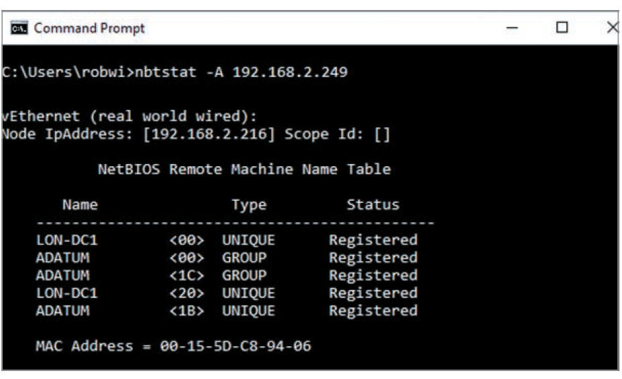
NetBIOS Enumeration Tools (2 of 5)
Source: Kali Linux
Figure 6-2 Using the Nbtstat command

Slide 23
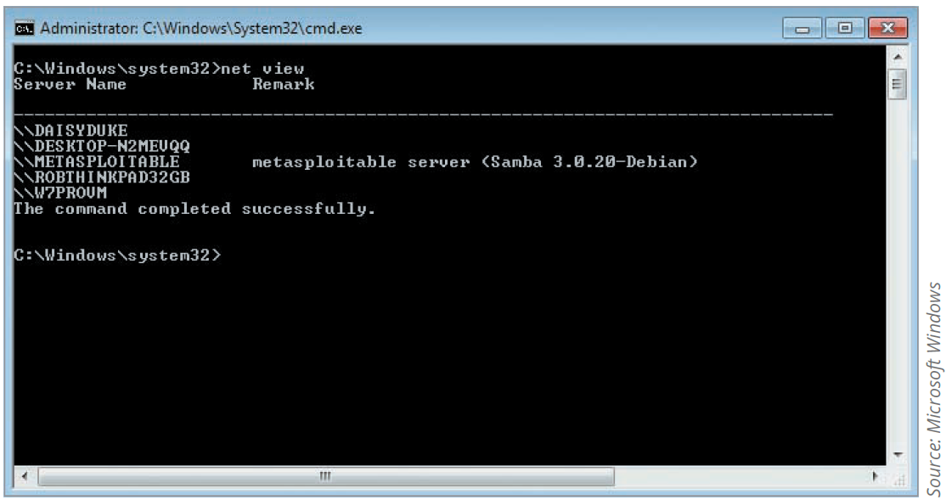
NetBIOS Enumeration Tools (3 of 5)
Another built-in Windows tool is the net view command
Shows shared resources on a computer or server
To display syntax for this command, type net view ?

Slide 24
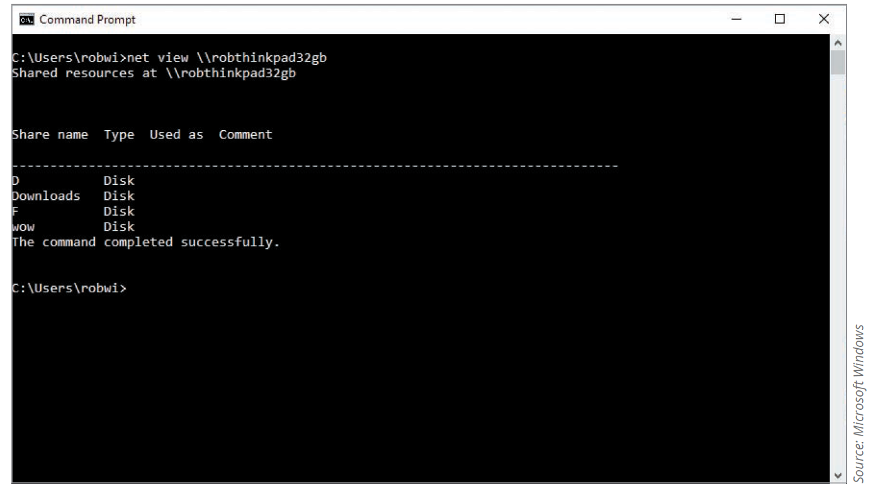
NetBIOS Enumeration Tools (4 of 5)
You can also use the IP address or hostname of computers you discovered with port-scanning tools

Slide 25
NetBIOS Enumeration Tools (5 of 5)
Although you can download or buy enumeration tools, you should learn how to take advantage of the tools available in Windows
A simple command-line utility can give you the name of a logged-on user
User’s password can then be guessed in order to gain access to a system

Slide 26
Additional Enumeration Tools (1 of 9)
enum4linux
Enumeration tool for Windows and Samba systems
Written in Perl and uses the Samba tools smbclient, rpclient, net, and nmblookup
Must run it on a system that supports Perl, such as Kali Linux

Slide 27
Additional Enumeration Tools (2 of 9)
DumpSec
Enumeration tool for Windows NT, 2000, and XP systems
Does not work well on newer versions of Windows
Produced by Foundstone, Inc.
Allows user to connect to a server and “dump” the following information:
Permissions for shares
Permissions for printers
Permissions for the Registry
Users in column or table format
Policies
Rights
Services

Slide 28
Additional Enumeration Tools (3 of 9)
Hyena
Excellent GUI tool for managing and securing Windows OSs
Easy to use interface
Gives security professionals a wealth of information
Paid-for tool but has a free trial you can experiment with
Shows shares and user logon names for Windows servers and domain controllers
Displays graphical representation of:
Microsoft Terminal Services
Microsoft Windows Network
Web Client Network
Find User/Group

Slide 29
Additional Enumeration Tools (4 of 9)
OpenVAS (known as Greenbone Security Assistant)
Operates in client/server mode
Open-source descendant of Nessus
Popular tool for identifying vulnerabilities
Nessus Server and OpenVAS
Compatible with, and easy to install on, Kali Linux
Can use these tools interchangeably for most purposes when enumerating systems
Nessus Essentials
Latest version can run on Windows, macOS, and Linux distributions
Handy tool when enumerating different OSs on a large network

Slide 30
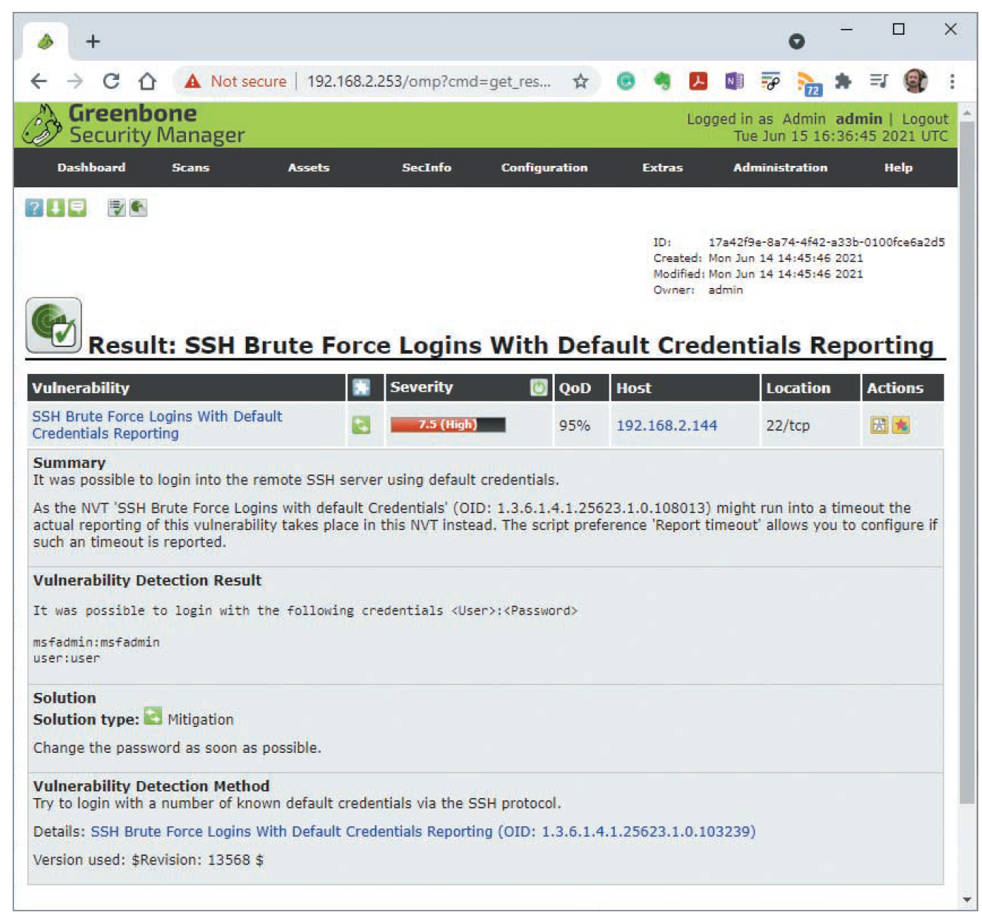
Additional Enumeration Tools (5 of 9)
Source: Greenbone Security
Figure 6-9 OpenVAS enumerating a SSH Brute Force Logins With Default Credentials Vulnerability

Slide 31
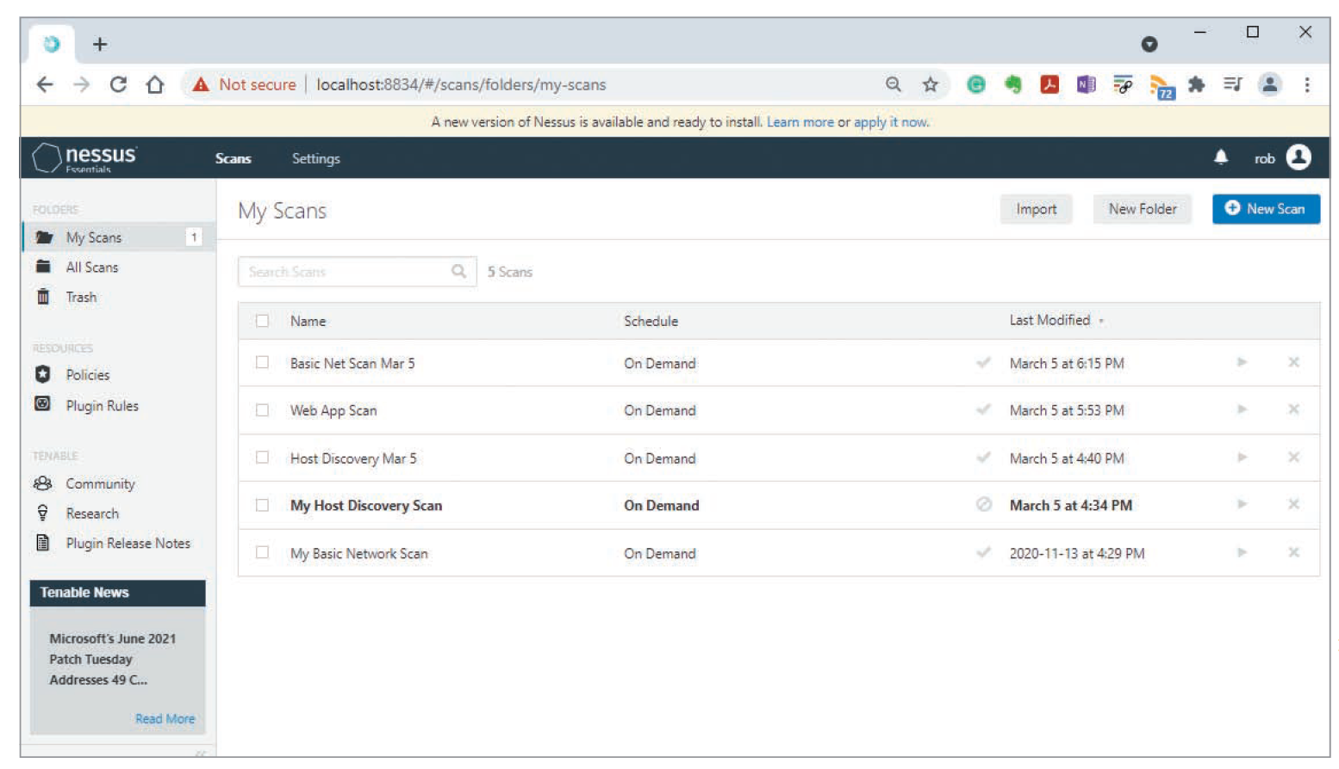
Additional Enumeration Tools (6 of 9)
Figure 6-10 Nessus Scans page
Source: Tenable

Slide 32
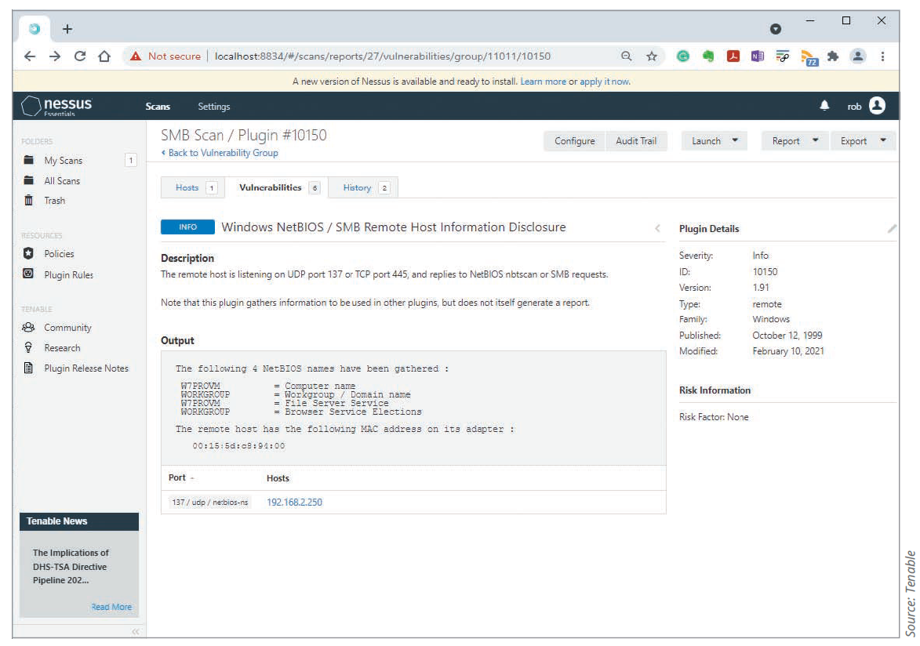
Additional Enumeration Tools (7 of 9)
The next several figures show Nessus in action
This figure shows information Nessus has discovered using NetBIOS

Slide 33
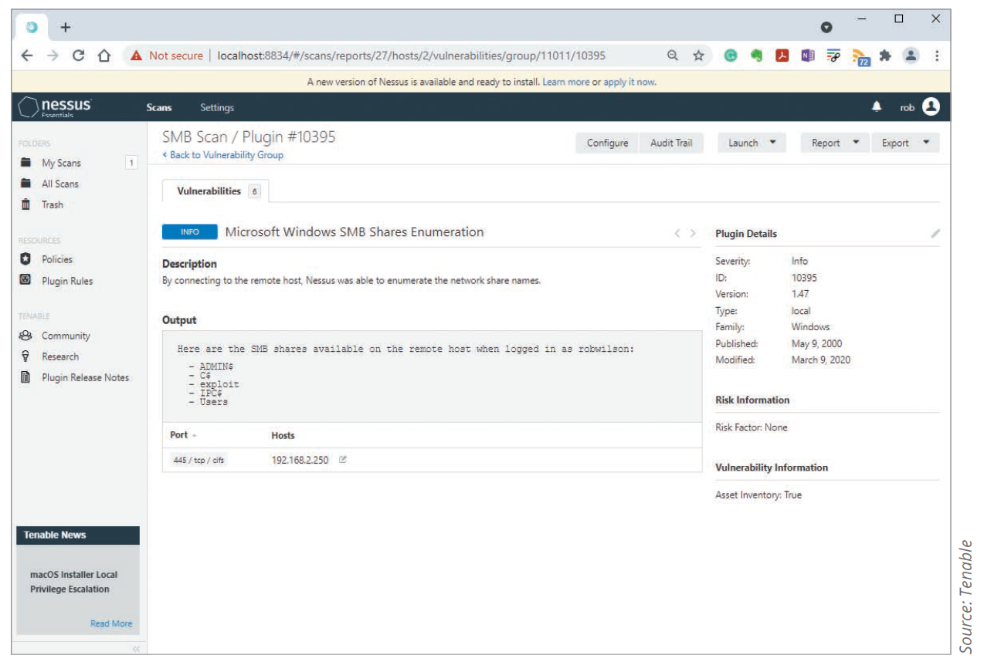
Additional Enumeration Tools (8 of 9)
Additional Nessus scan to enumerate Server Message Block (SMB) shares has provided a list of folders that are accessible via SMB in this figure

Slide 34
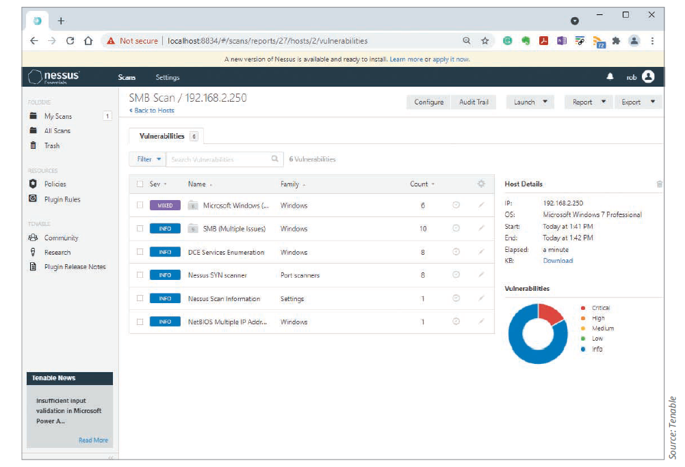
Additional Enumeration Tools (9 of 9)
Nessus is helpful in identifying the OS and service pack running on a computer

Slide 35
Polling Activity 6-2
Which of the following tools can be used to enumerate Windows systems? (Choose all that
apply.)
a. OpenVAS or Nessus
b. Reddit
c. DumpIt
d. Hyena
Notes:
Instructions:
1. Use this activity to solicit student opinions about concepts in the module or to play a game.
2. Go to kahoot.com, or the platform of your preference, and log in or sign up.
3. Create the challenge.
4. Teacher Tip: Turn off the timer to prioritize accuracy or turn on the nickname generator to avoid inappropriate nicknames.
5. Invite players by sharing the link or PIN.
6. This can be done synchronously during class or asynchronously for review or homework.

Slide 36
Polling Activity 6-2: Answer
Which of the following tools can be used to enumerate Windows systems?
Answer: a. and d. OpenVAS or Nessus and Hyena
Hyena is an excellent GUI tool for managing and securing Windows OSs. Nessus and OpenVAS are also both compatible with Windows OS systems.

Slide 37
Knowledge Check Activity 6-2
Which of the following is a Windows command-line utility for seeing NetBIOS shares on a network?
Net use
Net user
Net view
Nbtuser
Notes:
Instructions:
Use the Knowledge Check questions to periodically pose a question to students during class to gauge how well they can recall the material that was presented.

Slide 38
Knowledge Check Activity 6-2: Answer
Which of the following is a Windows command-line utility for seeing NetBIOS shares on a network?
Answer: c. Net view
The net view command is a simple command-line utility that allows an attacker to view remote NetBIOS shares on a network.

Slide 39
Discussion Activity 6-1
Perform a Net view scan of your own computer. Write a brief report (three paragraphs) of your findings. Were you surprised by any of the shares you discovered? Discuss the shares you discovered and why they are there with your classmates.
Notes:
Instructions:
Use the Discussion activity to encourage group conversation about a related topic of interest.

Slide 40
Discussion Activity 6-1: Answer
Perform a Net view scan of your own computer. Write a brief report (three paragraphs) of your findings. Were you surprised by any of the shares you discovered? Discuss the shares you discovered and why they are there with your classmates.
Answer: The student should at least find the administrative shares that are automatically made for each drive letter—C$ and D$—and admin$ and IPC$. These shares may be a surprise to the student. The report should mention these shares and any other shares that are found, the name or IP address of the computer, and a description of what these shares are.

Slide 41
Enumerating *nix Operating System
Several variations of UNIX
Solaris and OpenSolaris
HP-UX
Mac OS X and OpenDarwin, based on FreeBSD
AIX
BSD UNIX
FreeBSD
OpenBSD
NetBSD
Linux, including several distributions

Slide 42
*nix Enumeration (1 of 6)
Simple Network Management Protocol (SNMP)
An old but still popular network management service for network administrators that enables remote administration
Can run on both Windows and *nix
This section focuses on *nix
SNMP is useful for administrators who want to see:
System statistics
Version numbers
Other detailed host information remotely
SNMP is also useful for hackers

Slide 43
*nix Enumeration (2 of 6)
SNMPWalk
A tool useful in enumerating hosts running SNMP with the default configuration
If attackers know the processor architecture and the detailed version number of the remote operating system, they will have an easier time finding exploits that will be successful
The SNMP daemon (snmpd) listens on UDP port 161
SNMP often runs on network hardware such as routers, switches, and firewalls

Slide 44
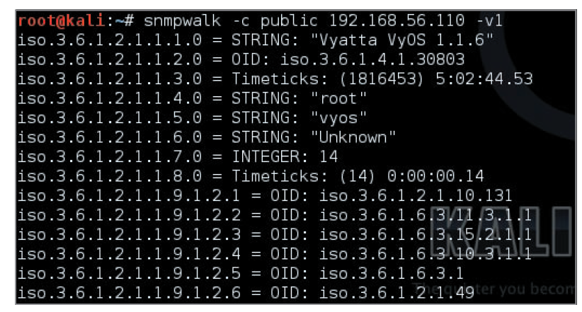
*nix Enumeration (3 of 6)
Source: GNU Open Source License
Figure 6-14 Using the SNMPWalk command

Slide 45
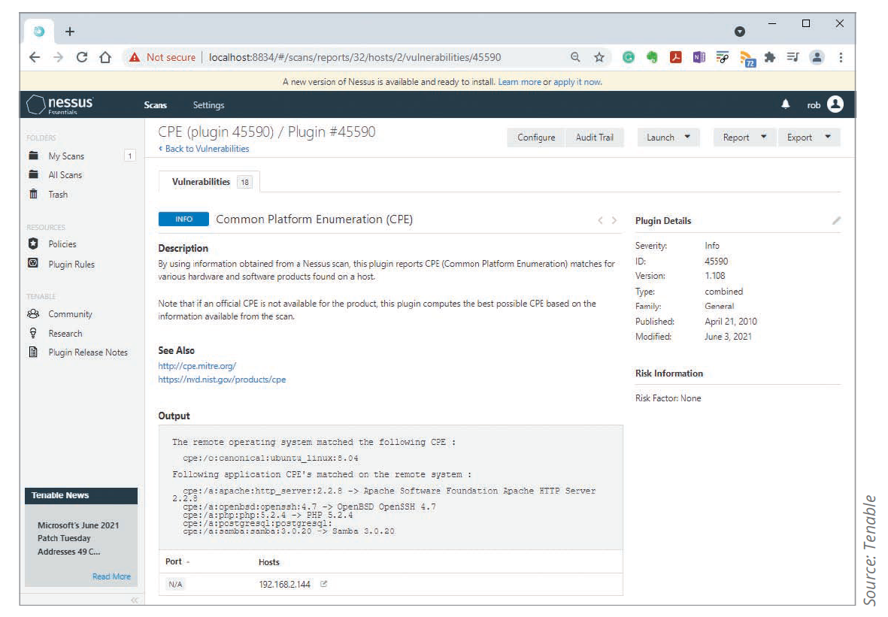
*nix Enumeration (4 of 6)
Nessus is helpful in *nix enumeration
This figure shows what Nessus found when scanning a Ubuntu 15.10 system

Slide 46
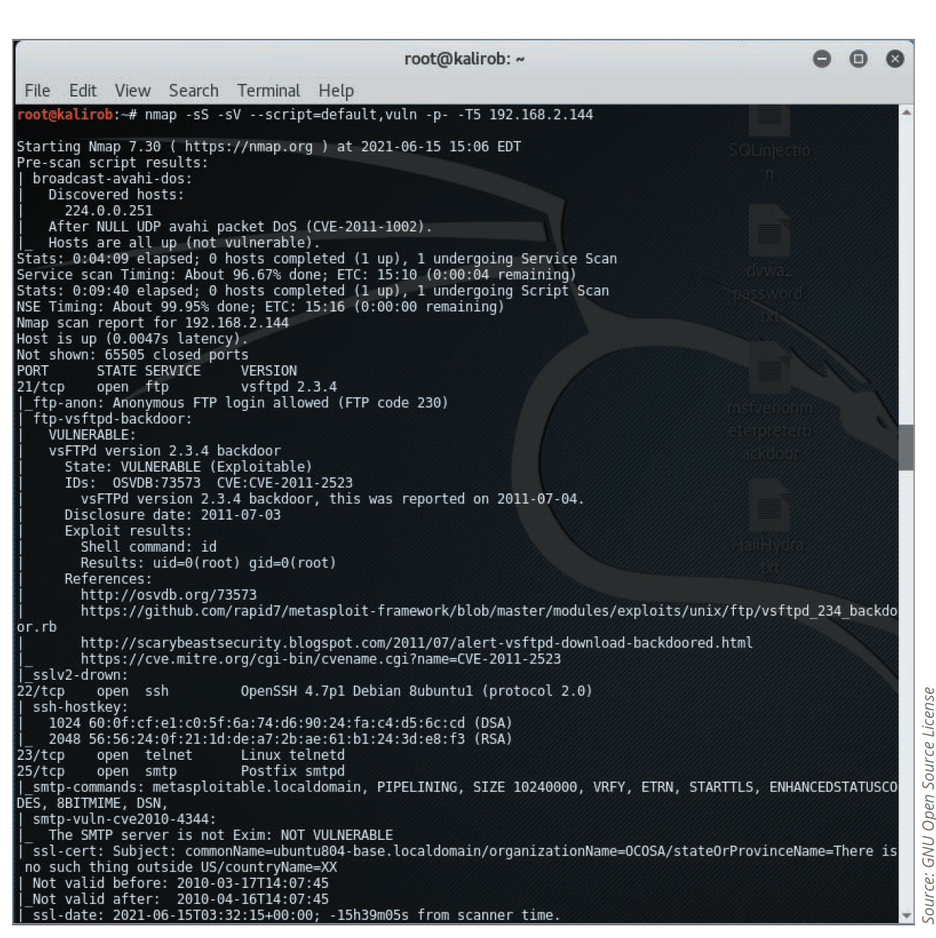
*nix Enumeration (5 of 6)
NMap script scanning can also help an attacker gain information about remote *nix hosts

Slide 47
*nix Enumeration (6 of 6)
Finger utility
An older but sometimes useful enumeration tool for security testers and hackers
Enables you to use a single command to find out who is logged on to a *nix system
The Finger daemon (fingerd) listens on TCP port 79

Slide 48
Self-Assessment
Recall the kinds of information that can be gathered with the help of enumeration.
Notes:
Instructions:
Use the Self-Assessment question to encourage students to evaluate their progress or goals in the course, as well as determine how they might apply their learning or grow as an individual.

Slide 49
Summary
Now that the lesson has ended, you should be able to:
Describe the enumeration step of security testing
Enumerate Windows OS targets
Enumerate *nix OS targets

